Slide 1
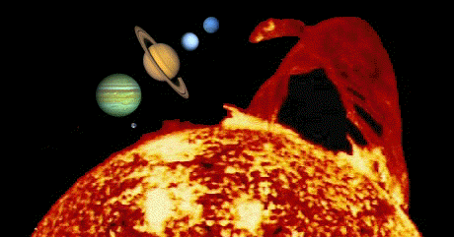
Introduction to Astronomy
The Evansville Astronomical Society
www.EvansvilleAstro.org
Wahnsiedler Observatory
All Donations Welcome

Slide 2
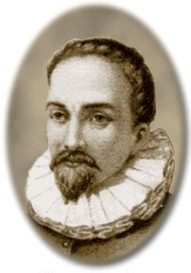
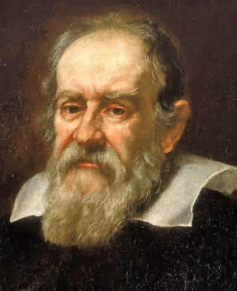
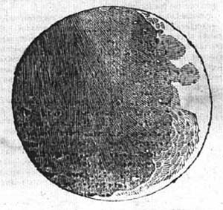
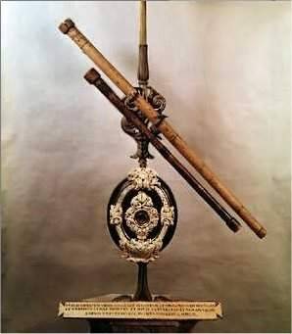
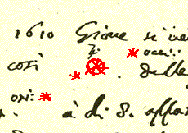
In 1608 Hans Lippershey invented the 1st telescope. The following year Galileo Galilei turned this new invention toward the heavens. He noticed that the moon was not a smooth sphere as many had believed. He also saw the four large moons orbiting Jupiter. This ultimately led to the Sun center solar system instead of an Earth center Solar System as most people believed at the time.
Hans Lippershey
Galileo Galilei

Slide 3
Refractor Telescope
Eyepiece
LIGHT
Refractors – Have no Mirrors
Benefits: Outstanding Optics, Great for Imaging
Disadvantages: Good Ones are Expensive.

Slide 4
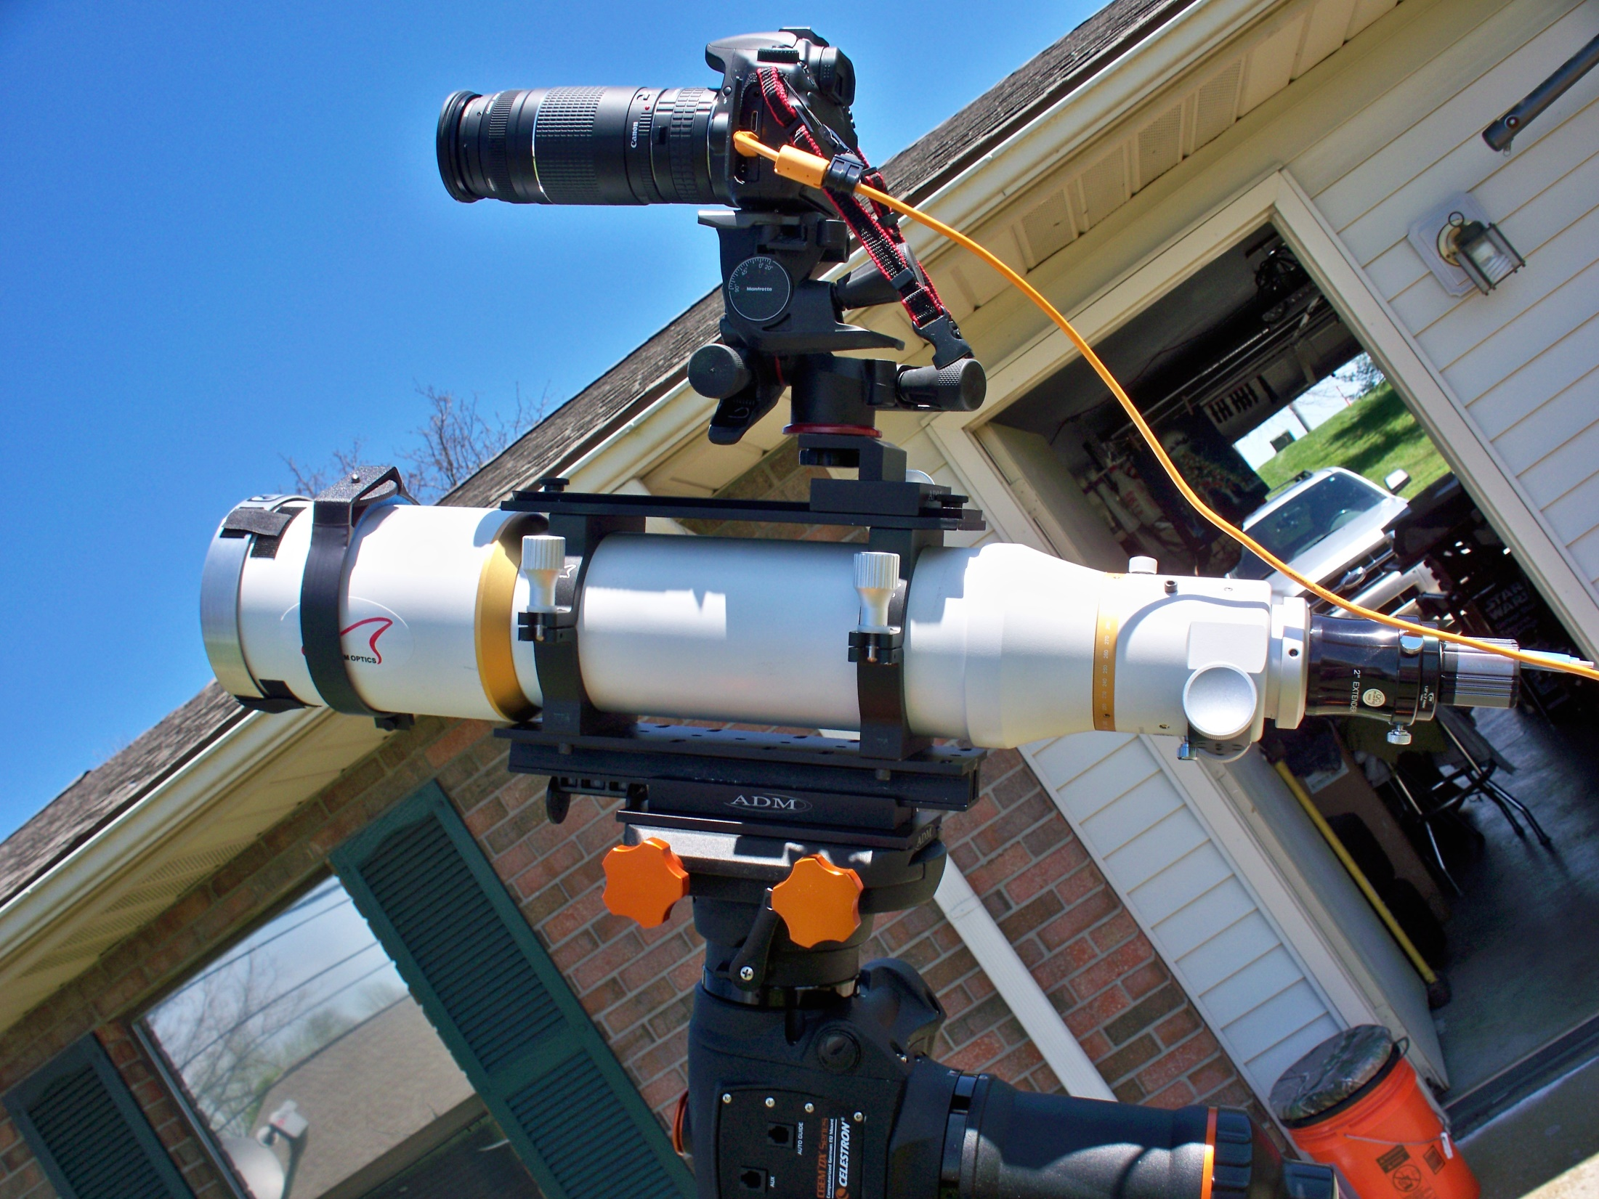
Photo by Dave Kube
Canon 60d w/ 300mm zoom and 2x and Solar Filter
Williams Optics 110mm Doublet(4-1/2”) and Solar Filter
Modern Refractor Telescope

Slide 5
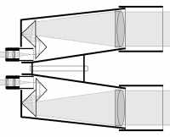
Binoculars Benefits: Inexpensive, Quick and Portable
LIGHT
No Mirrors

Slide 6
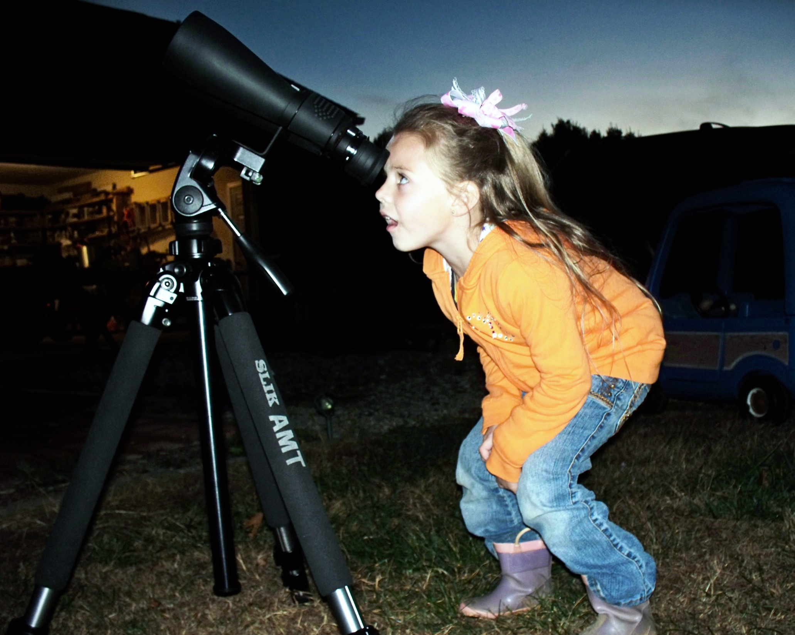
Celestron 70mm 10-18x zoom Binoculars
Photo by Dave Kube
Camera Tripod and Binocular Adapter
Binoculars
Side by Side Refractors
Aide of Adapter Mounts to Tripod

Slide 7
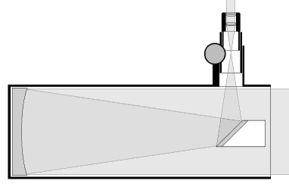
Reflector Telescope
MIRROR
LIGHT
Benefits: Quick set up, Easy to use, Wide price range.
Li
Disadvantages: Generally Unsuitable for Imaging without Tracking.

Slide 8
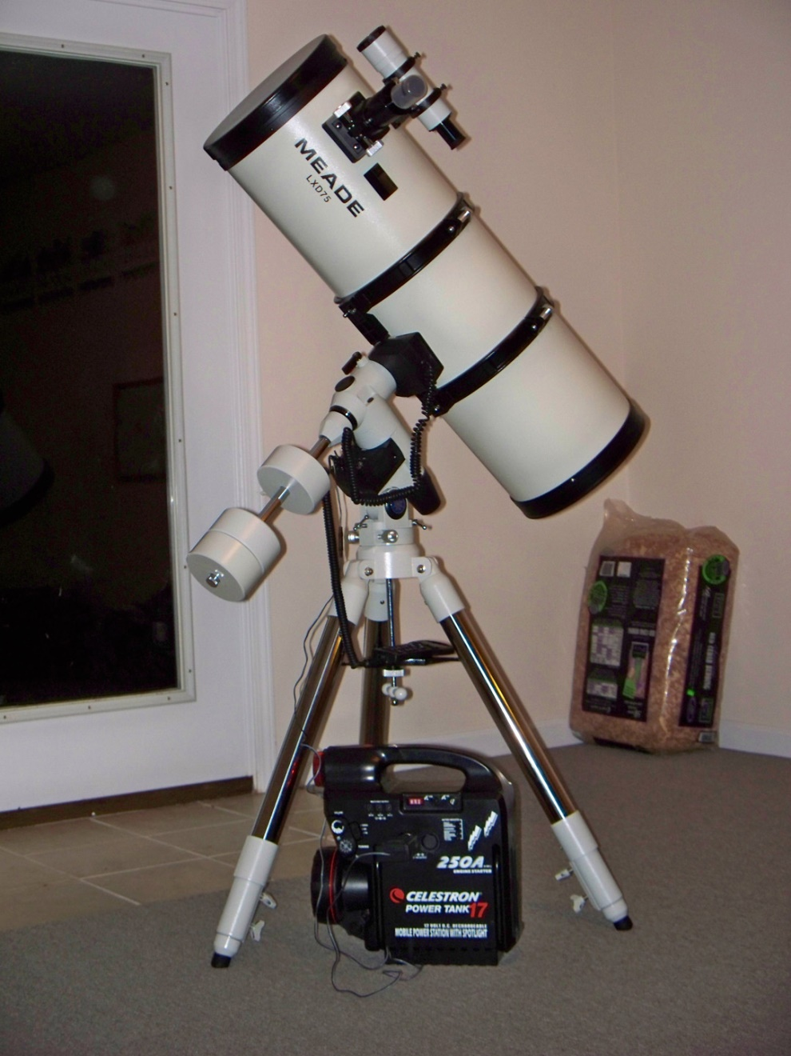
Photo by Dave Kube
Meade SN-10 Reflector on Meade LXD-75 German Equatorial Mount
Reflector Telescope
Disadvantage: Eyepiece @ Objective – need ladder

Slide 9
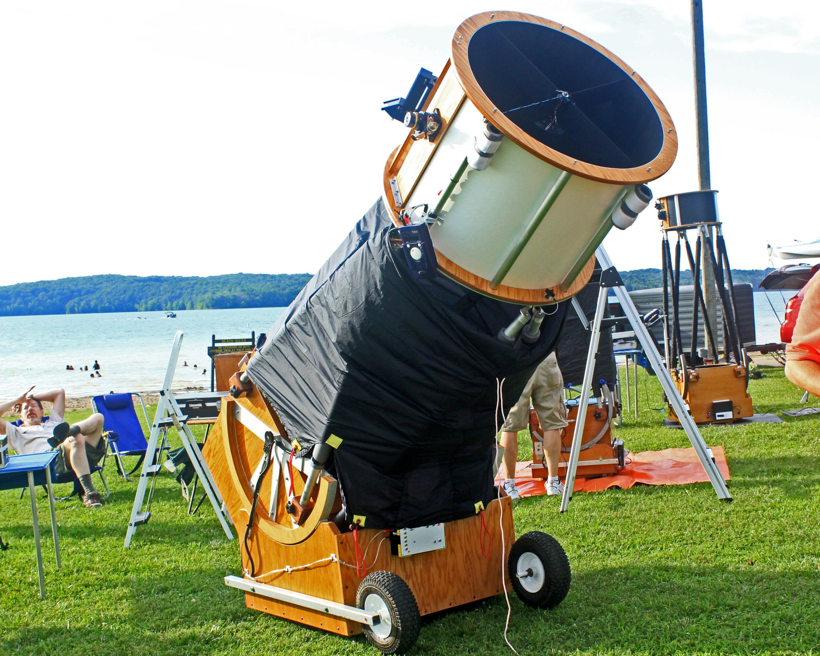
28” Reflector on Dobsonian Mount – Club Scope
Reflector on Dobsonian Mount
Photo by Dave Kube

Slide 10
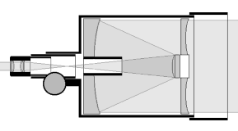
Schmidt Cassegrains
LIGHT
Benefits: Long focal length, good for imaging and compact.
Disadvantages: Very difficult to align, heavy and expensive, lengthy cool down time.

Slide 11
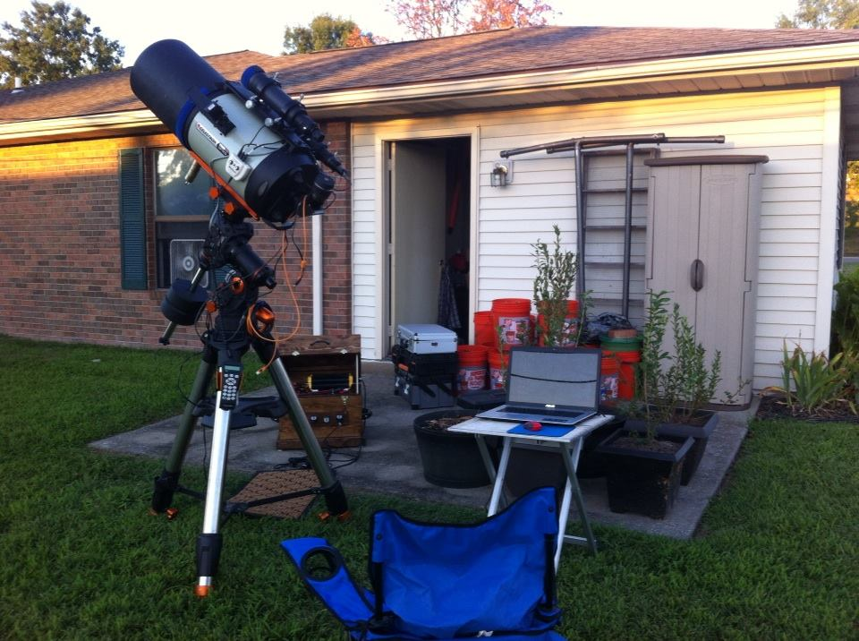
Finder Scope, Guide Scope and Telrad Finder
Dewshield and Dew Heater
Celestron 11” HD Cassagrain on Celestron CGEM DX German Equatorial Mount
Cassagrain Telescope
Photo by Dave Kube

Slide 12
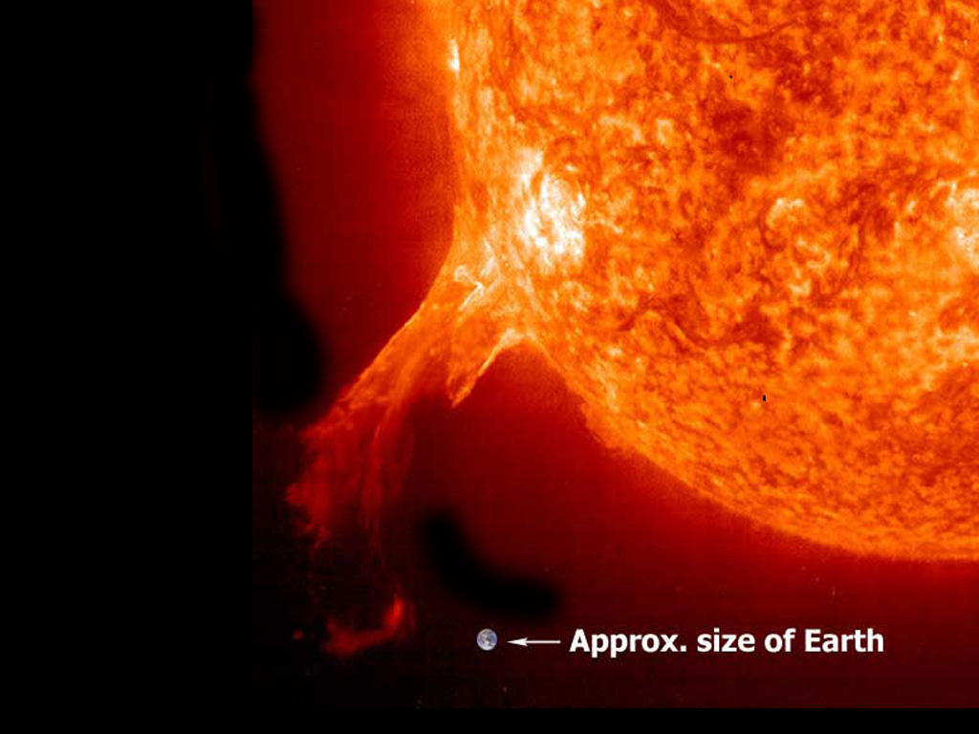
The Sun
Makes up 99.86% of all the mass in our solar system.
The sun is 864,000 miles in diameter. If you could drive a car on the surface at 55 mph, it would take 5.6 years to circle it one time.
The sun is made up of 92.1% Hydrogen, 7.8% helium, and .1% everything else
Notes:
Solar Elemental Abundances Element Number % Mass %
Hydrogen 92.0 73.4
Helium 7.8 25.0
Carbon 0.02 0.20
Nitrogen 0.008 0.09
Oxygen 0.06 0.8
Neon 0.01 0.16
Magnesium 0.003 0.06
Silicon 0.004 0.09
Sulfur 0.002 0.05
Iron 0.003 0.14

Slide 13
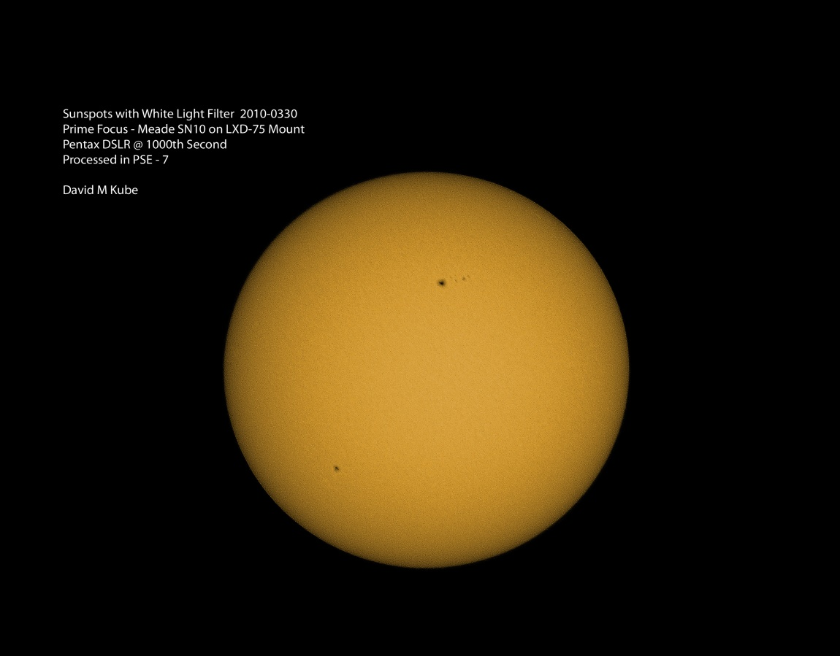
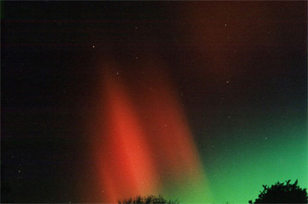
The Sun
Photo by Dave Kube
Has a core temperature of 28 million degrees and a surface temperature of 10,000 degrees.
It has dark spots called Sunspots. These are cooler areas of the sun caused by magnetic fields.
Magnetic fields and sunspots sometimes cause Solar flares which can lead to Auroras which are also known as the Northern or Southern Lights.
Photo by Scott Conner

Slide 14
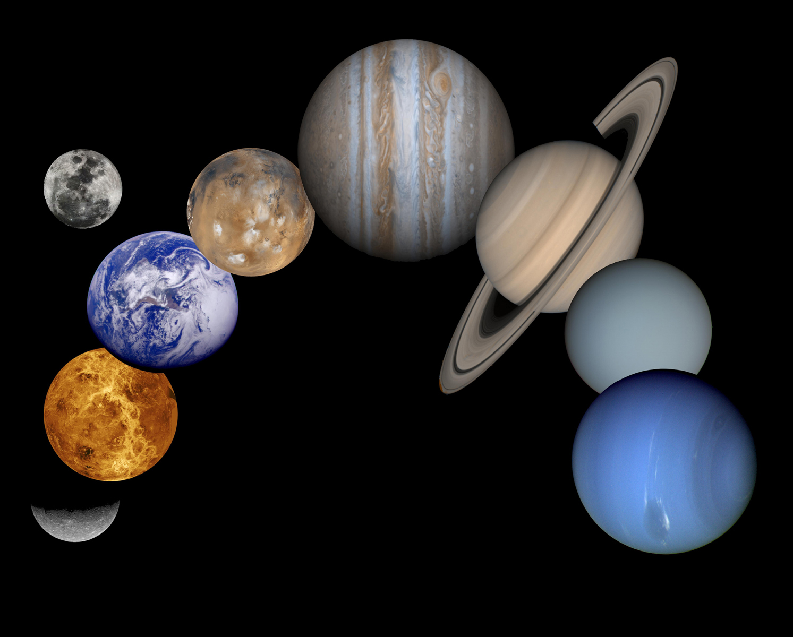
How can you remember the planets in order?
You can create a rhyme that uses the first letter of each planet to create a phrase.
Most Very Early Maps Just Show Us Nine Planets
My Very Eager Mom Just Served Us Nine Pizzas
As you can see we used the first letter of each planet in each word. The planets are as follows: Mercury, Venus, Earth Mars Jupiter Saturn Uranus Neptune & Pluto.

Slide 15
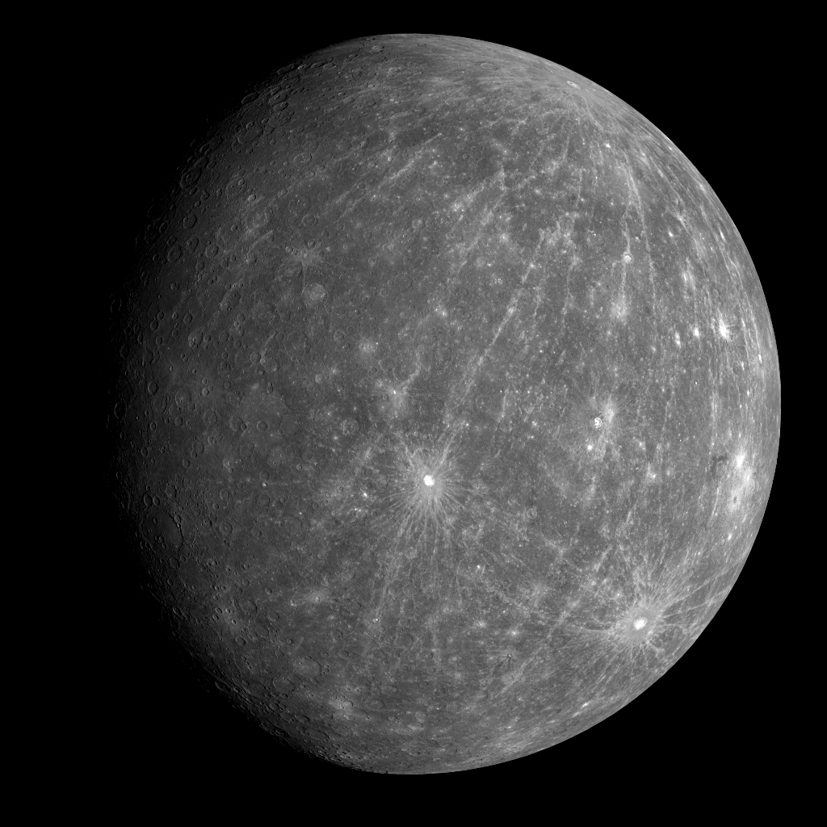
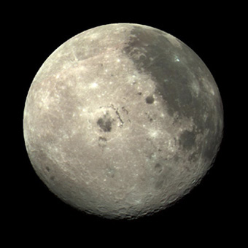
MERCURY
Is about 3032 miles in diameter. That is a little larger than our moon.
Notes:
Speed through space 50 Km per second.

Slide 16
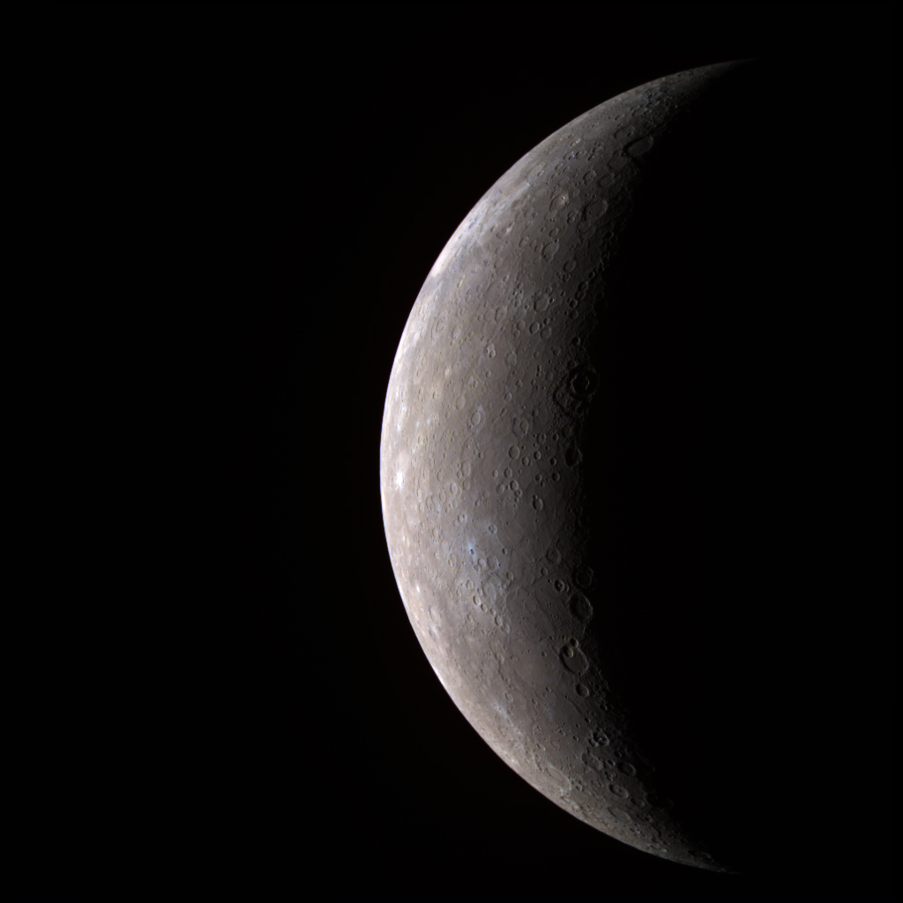
MERCURY
Is the closest planet to the Sun and resembles our Moon.
Mercury has no atmosphere, so the temperature ranges from +801 on the day side, to –279 on the night side.
Since Mercury has no atmosphere, the heavily cratered surface is not subject to erosion by wind and rain, so the surface is unchanged. Leaving behind all the scars from being bombarded by asteroids, meteors & comets that were drawn towards the Sun in the early years of the solar system.
Mercury moves through the sky quickly because it is close to the Sun, about 36 million miles.

Slide 17
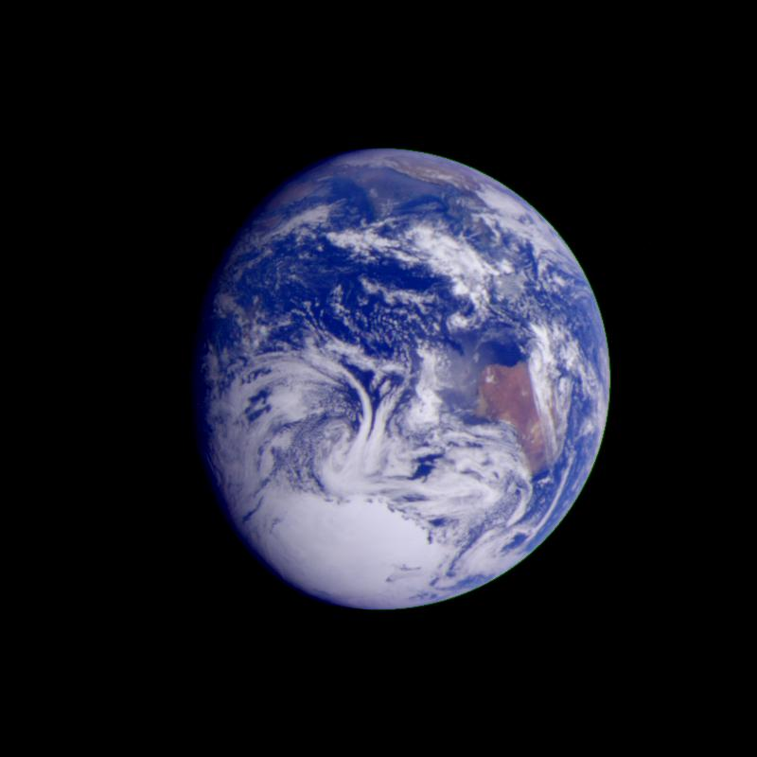
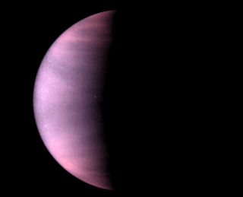
Venus
Is just a little smaller than the Earth.
From space it looks like a tropical world shrouded in clouds, but that is not what it is like at all.

Slide 18
From 1970-1983 the Soviet Union sent multiple Venera space crafts to Venus with some landing on the surface, they learned it was anything but tropical.
The longest survival time for the landers was two hours and seven minutes because of the harsh conditions discovered.
The atmosphere was mainly CO2 (Carbon Dioxide) which is a greenhouse gas. This makes the atmosphere very hot and dense. The temperature was 864 degrees and the atmospheric pressure was nearly 90 times that of earth. That is equal to the pressure of being under 3,000 ft of water!
To make things worse it has lightning and clouds containing sulfuric acid.

Slide 19
Venus
This view of Venus was made from radar observations. It shows the features we would see if there were no clouds.
Venus is the only planet in the solar system that rotates in retrograde. This means it revolves from East to West instead of West to East. If you could see the Sun rise on Venus, it would rise in the West and Set in the East.

Slide 20
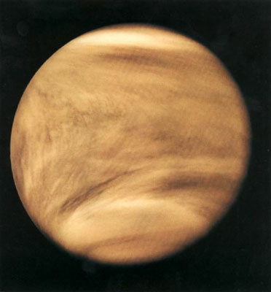
Venus
Takes 224.6 Earth days to orbit the Sun (which = 1 Venutian year)
Venus takes 243 Earth days to revolve 1 time. (which = 1 Venutian Day) That means its day is longer than its year.
Venus in Ultraviolet Light
Venus is 67 Million miles from the sun.

Slide 21
Why is Earth a beautiful Water World and Venus a World of Horrid conditions?
1st Earth is a little further from the Sun 93 million miles (or as a measurement astronomers use, 1 Astronomical Unit).
2nd Earth has life! Life has become a part of our planet. These two things help keep Earth’s atmosphere in balance.
Notes:
Orbital Velocity 66,000 MPH Escape Velocity 25,000 mph

Slide 22
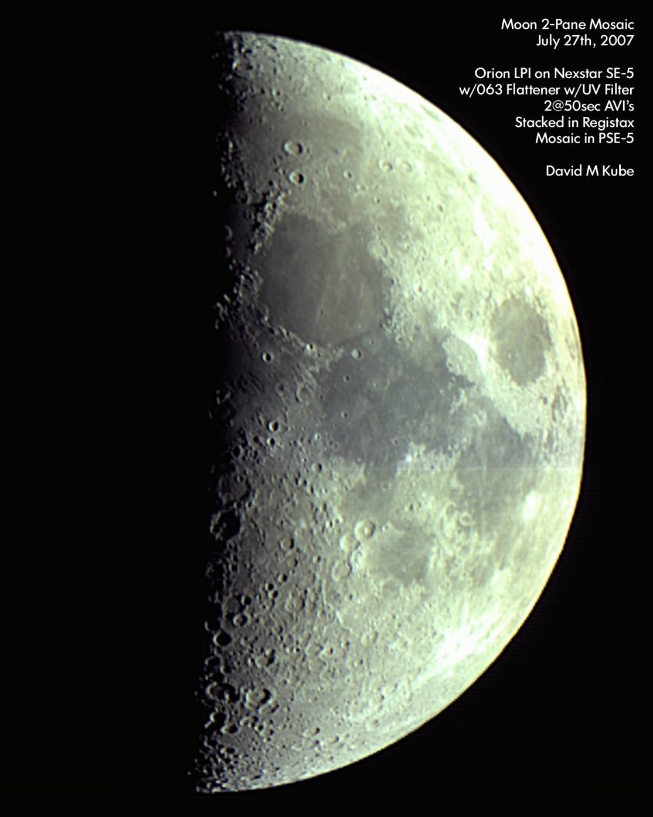
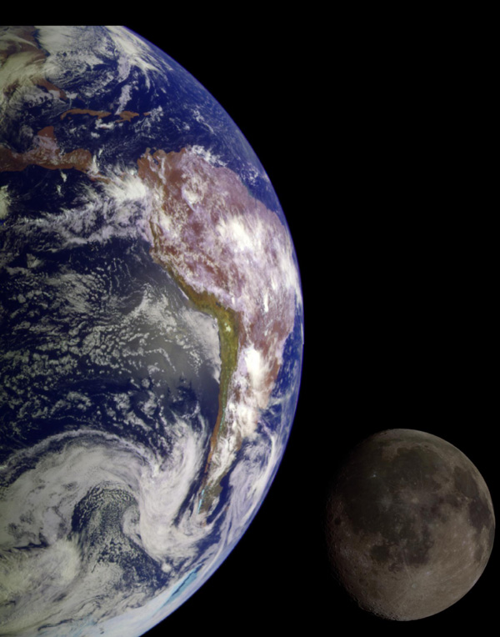
Earth is the 1st planet we have come to that has a moon.
The moon is 2158 Miles in Diameter and orbits the Earth at an average distance of about 240 thousand Miles.
Please Note the Detail at the Terminator
Earth and Moon as seen from the Galileo Spacecraft on its way to Jupiter.

Slide 23
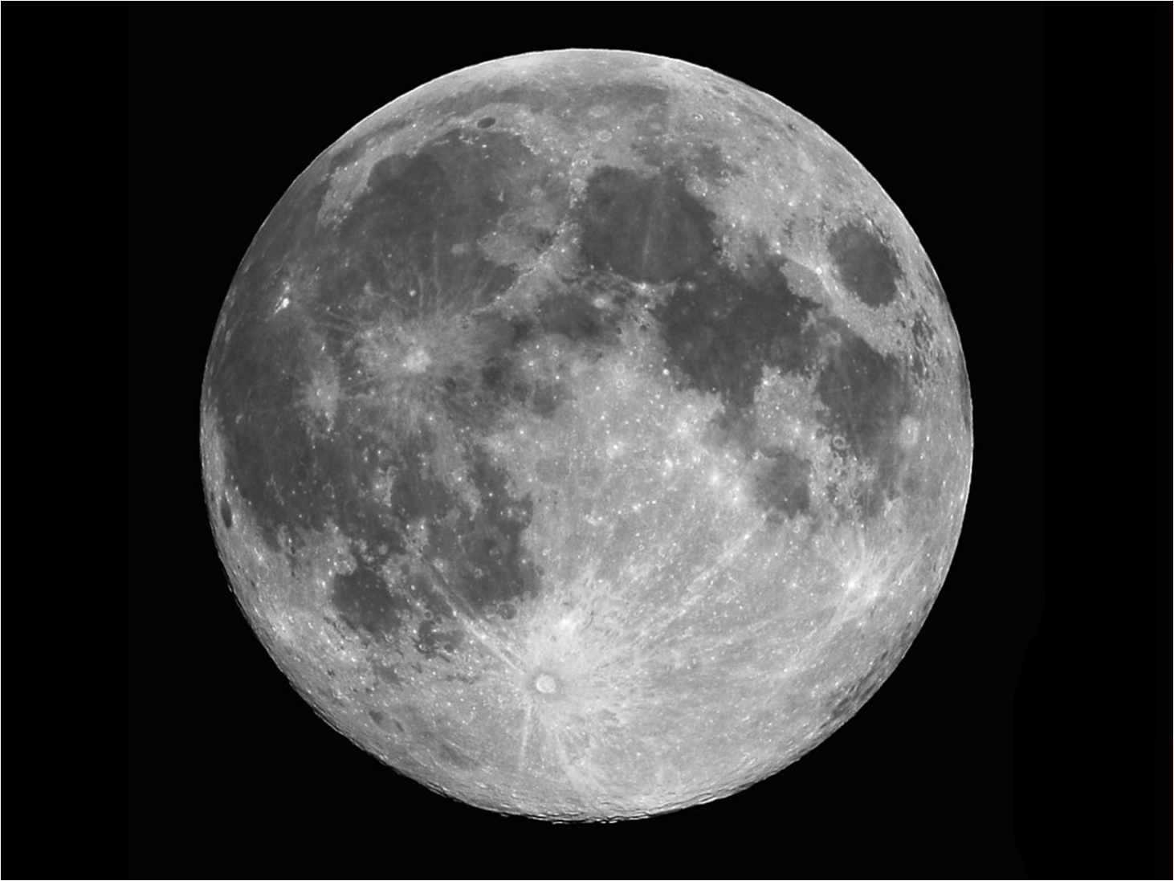
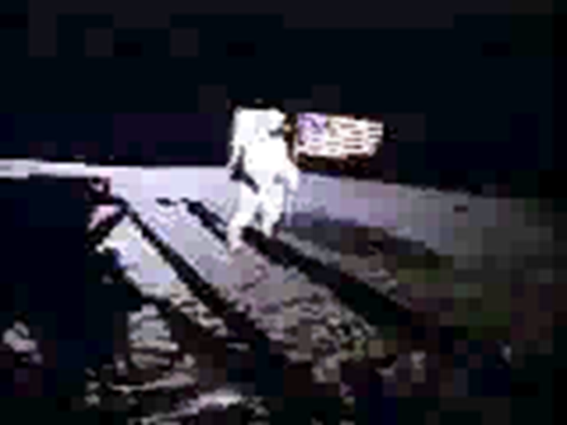
The Moon
Is the only other body in the solar system that man has walked on.
During the 6 visits to the moon, astronauts collected samples, took pictures, did experiments, and played golf.
Notice Lack of Detail

Slide 24
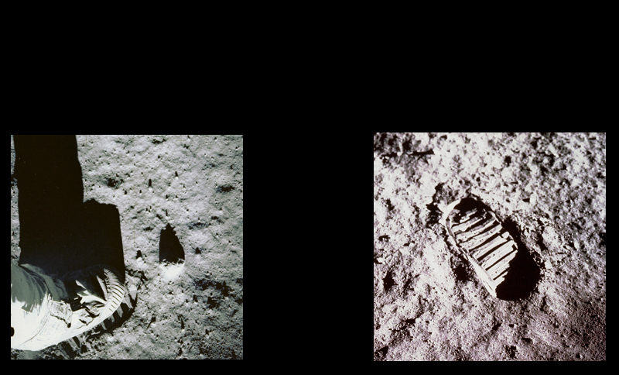
Moon
Since the moon has no atmosphere, there is no wind or rain to wash away their footprints. They will remain undisturbed until man visits the moon again.

Slide 25
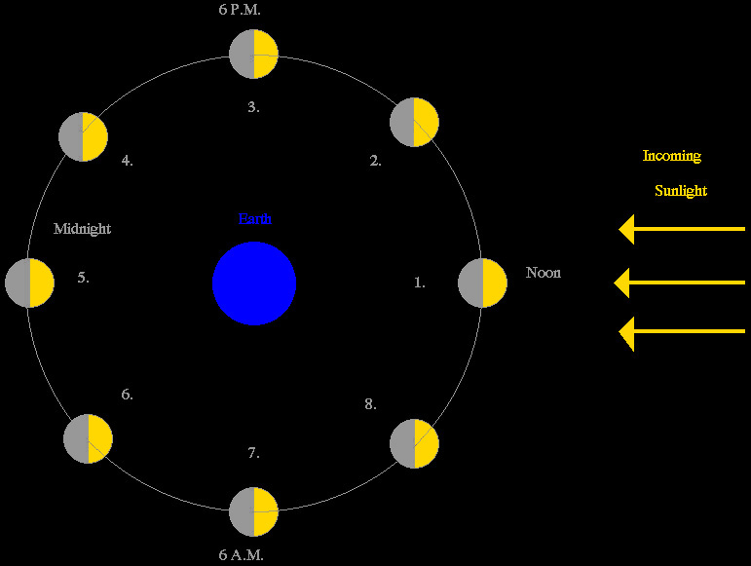
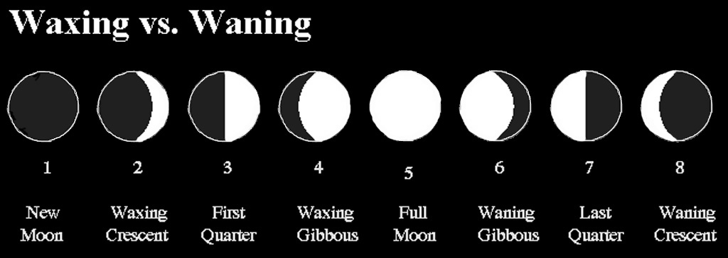
The Moon
This graphic explains the phases of the moon. The Sun is located off the right edge of the screen, the Earth is in center and the number corresponds to the view below.
The moon completes one orbit around the Earth every 27.3 days, which is the same amount of time it takes to rotate one time, this means we always see the same side of the moon.

Slide 26
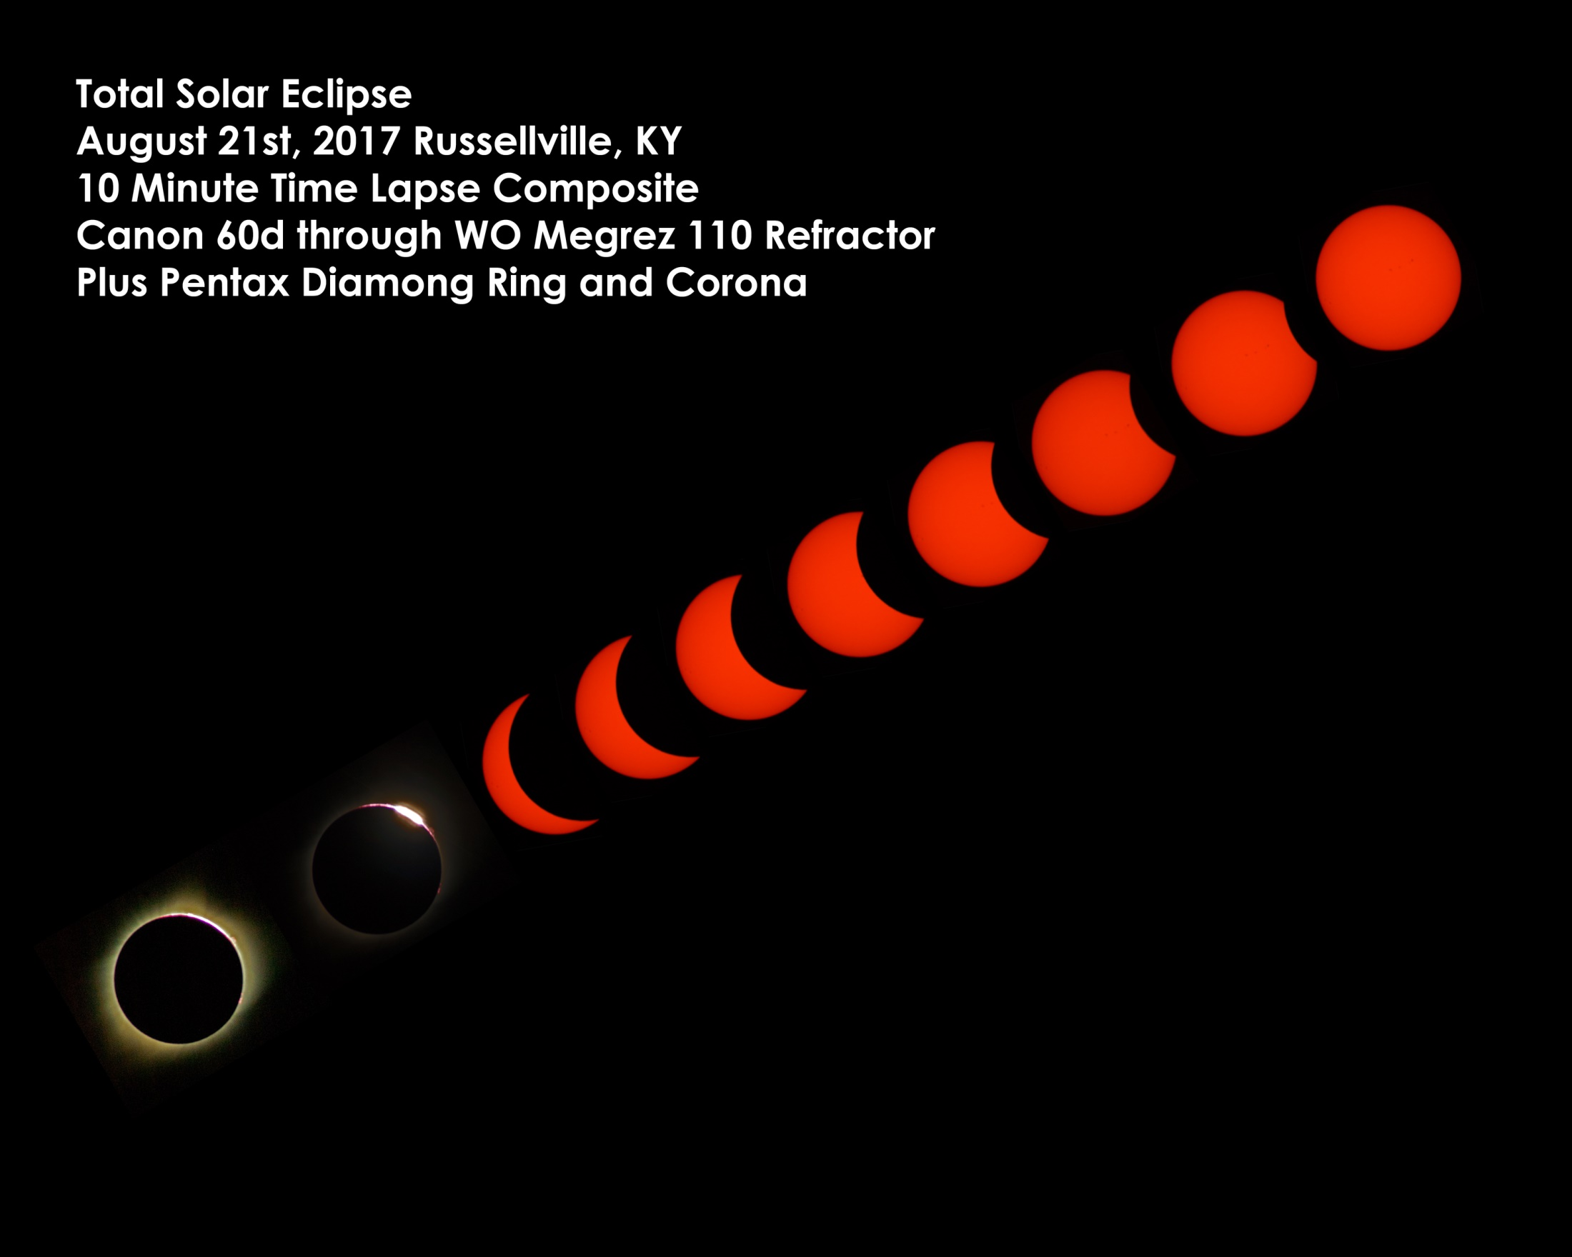
Moon Passes Between the Sun and Earth.
Blocks the Sunlight as the Earth passes through the Moon’s Shadow
New Moon
Total Solar Eclipse
Photo by Dave Kube

Slide 27
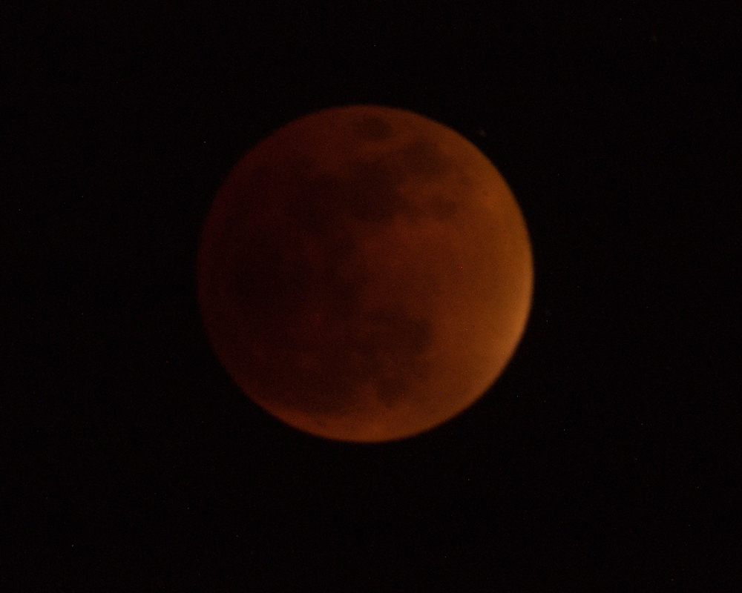
Full Moon
Lunar Eclipse
September 07, 2015
Photo by Dave Kube
Earth is Between the Sun and Moon.
Moon is in the Earth’s Shadow.
Red Color is Due to Sunlight Refracting through Earth’s Atmosphere

Slide 28
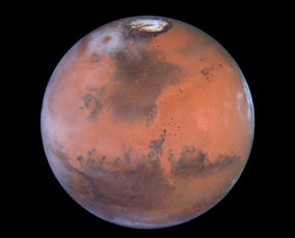
Mars
Has a diameter of 4200 miles which is only about half the size of Earth.

Slide 29
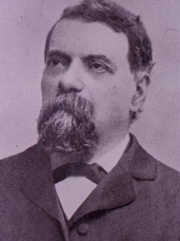
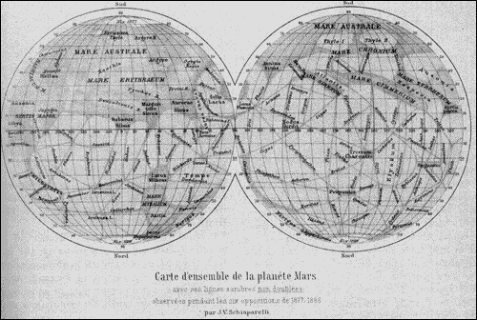
Mars
In the 1800’s an Italian astronomer named Giovanni Schiaparelli mapped what looked like unnaturally straight lines on Mars. It was thought that these were great canals built to carry water.
This fueled peoples imagination, and people started to believe there were little green men on Mars.
We know now that these were likely just lines in the lens of his telescope

Slide 30
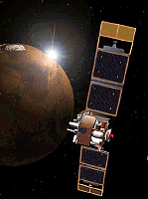
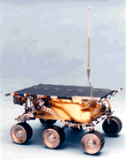
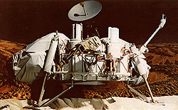
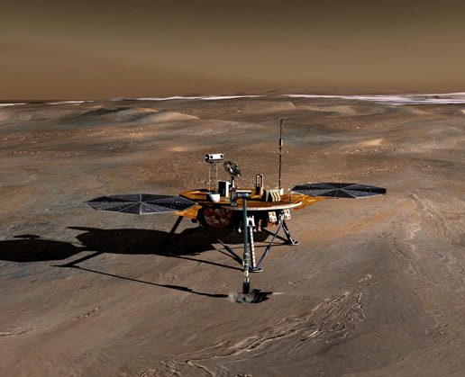
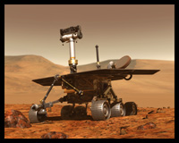
Mars
We have sent many spacecraft to Mars over the years. Some of them have made it, and some have not. Some of them are up there now!
Sojourner Rover
Viking Lander
Mars Global Surveyor
And there will be more to follow…
Spirit & Opportunity Rovers
Phoenix Lander

Slide 31
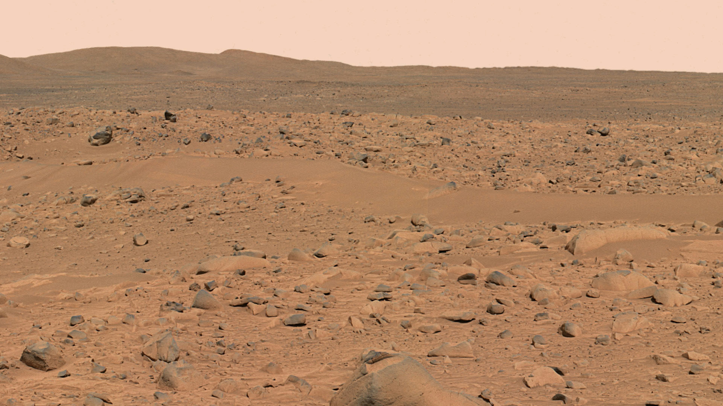
Mars
Data from our spacecraft now tell us that water does exist on Mars. It is locked up as ice under the surface and at its poles. In the past water once flowed freely on the surface, and created the Iron Oxide ( or Rust) in the soil which gives Mars its the red color.

Slide 32
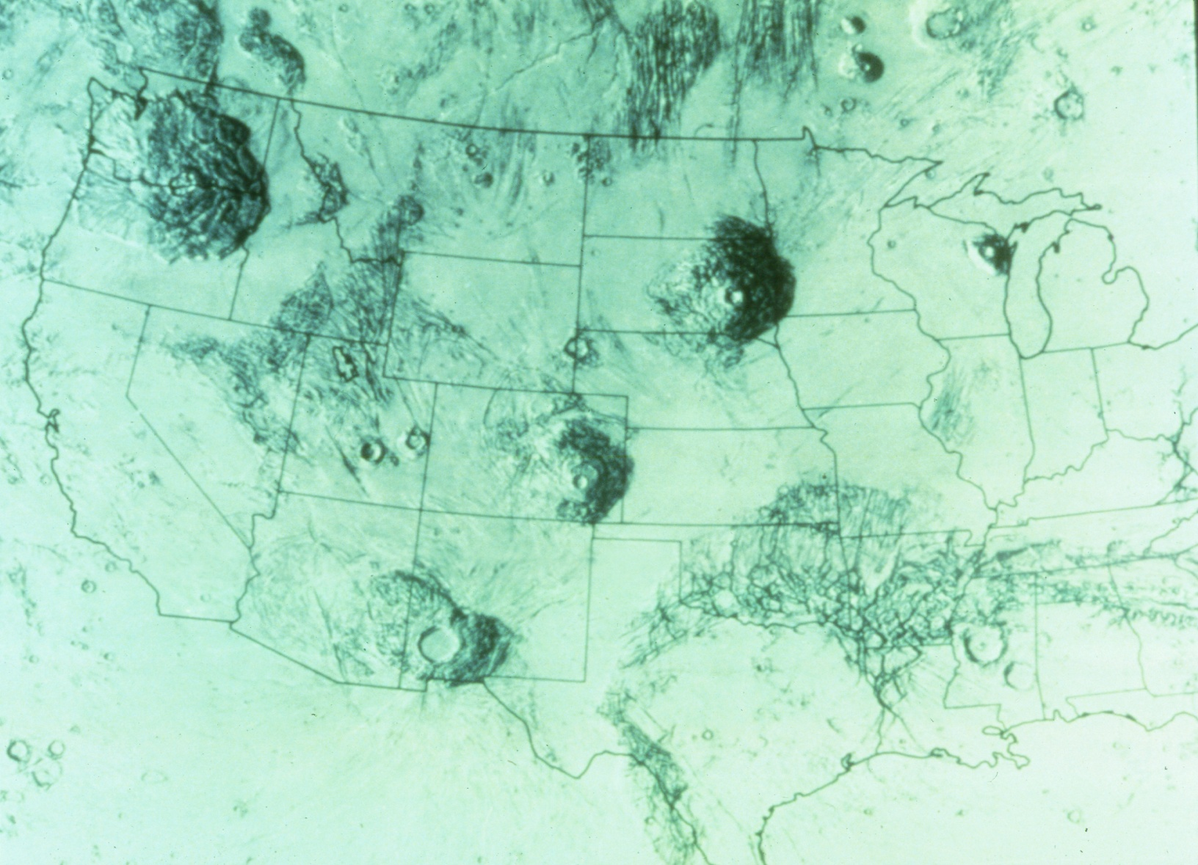
Mars
Has some of our solar systems largest features….
Olympus Mons is a volcano nearly 90,000 ft high. Its base would cover the state of Washington. All the volcanoes on Mars are thought to be dormant and not extinct.

Slide 33
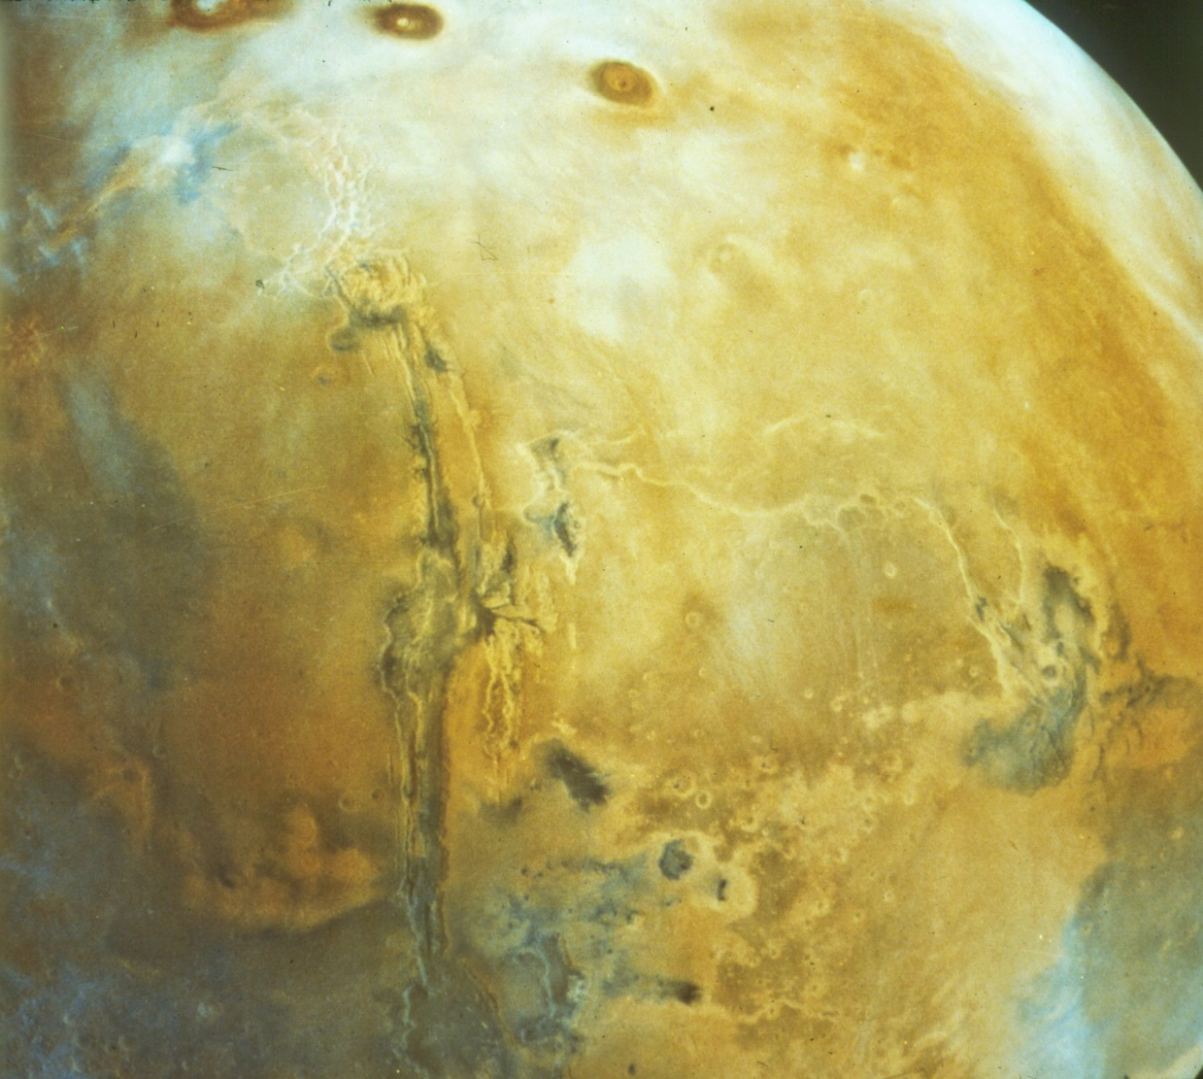
Mars
Also has the “Valles Marineris” or the Martian Grand Canyon.
It stretches more than 2500 miles, is 5 miles deep, and is over 150 miles wide in some places.

Slide 34
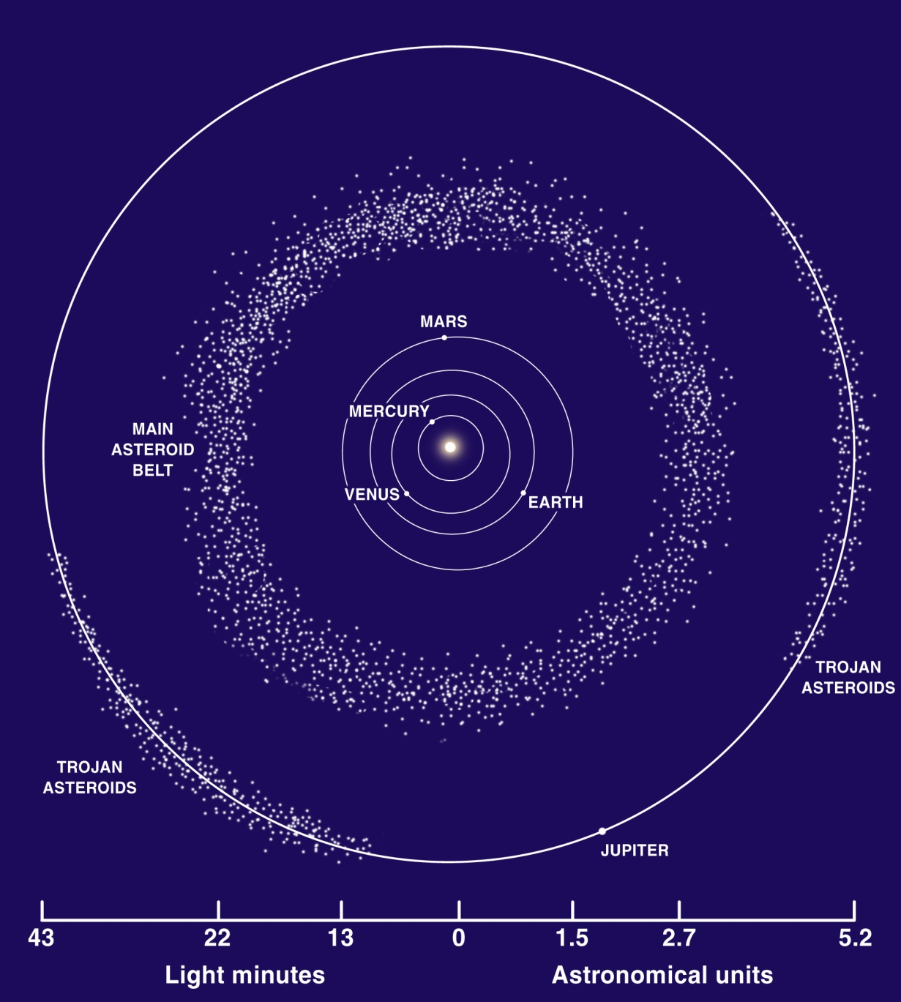
The Asteroid Belt
In between Mars and Jupiter is a belt of Asteroids orbiting the sun. There are millions of rocks ranging from a few meters to near 900 km across.

Slide 35
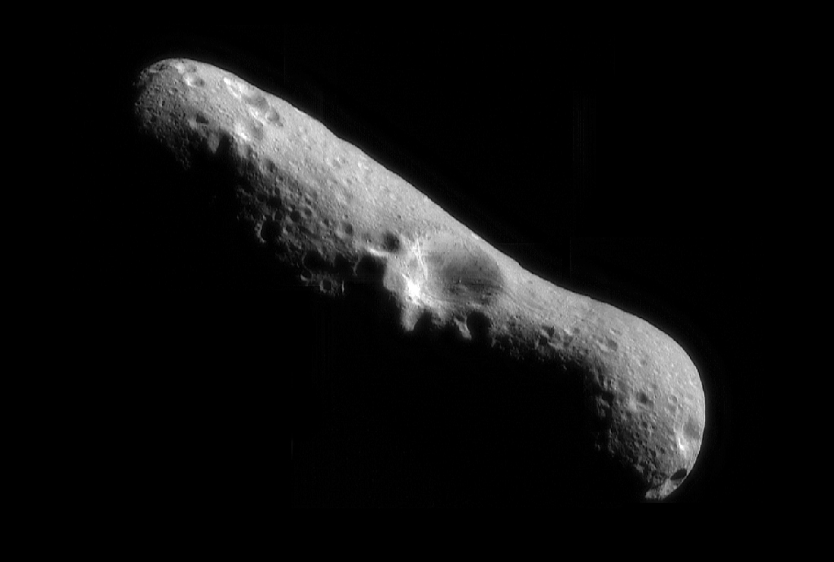
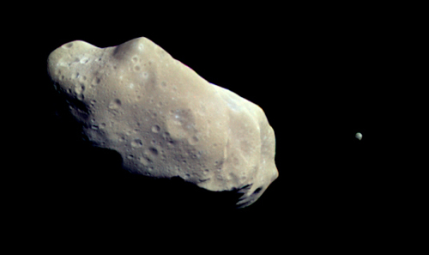
The Asteroid Belt
Eros
Some even have other asteroids orbiting them.
Ida & dactyl

Slide 36
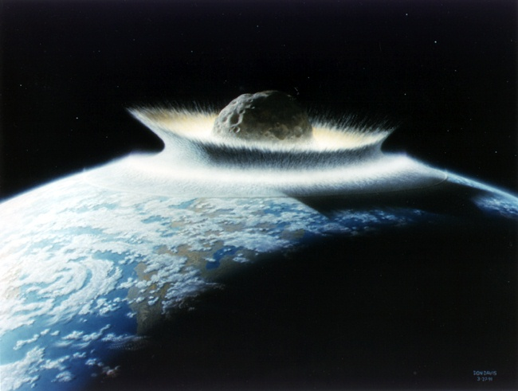
Asteroids
Every now and then a big one will hit the Earth. About every 60-100 million years. As of February 5, 2018, 886 NEA’s larger than 1 km have been discovered. On march 15, 2004 one missed us by just 26,000 miles. That was a close call. It was a small one (30 meters), but it could have destroyed a small town. It is Unlikely that a big hit will occur in our lifetime, but it is not impossible!

Slide 37
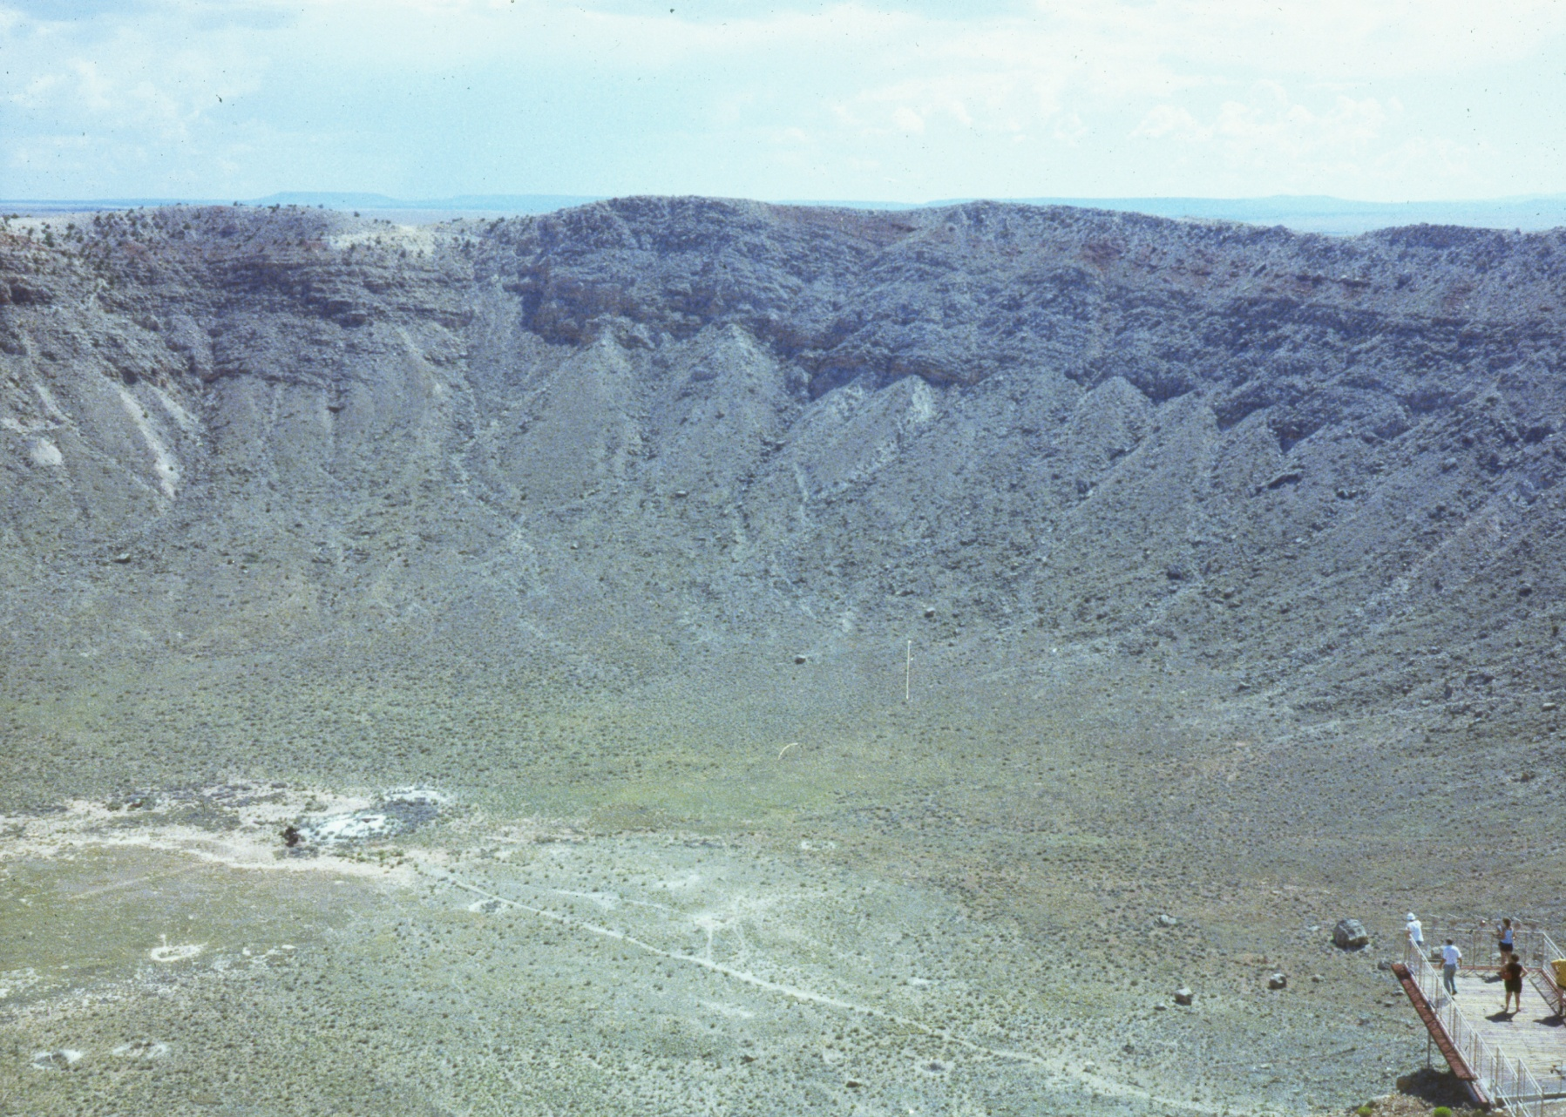
Asteroids
This is Meteor Crater in Arizona. It is 700 ft deep, and over 1 mile wide. It was caused by an Asteroid only 100 meters in diameter!

Slide 38
Meteors
Are usually much smaller. The typical size is the size of a grain of sand. They hit the atmosphere at speeds up to 140,000 mph. This heats up the air and causes the bright streaks we see.
Occasionally they are bigger like this one, and make it to the ground. These are called meteorites.
Notes:
Chevy Malibu in 1992

Slide 39
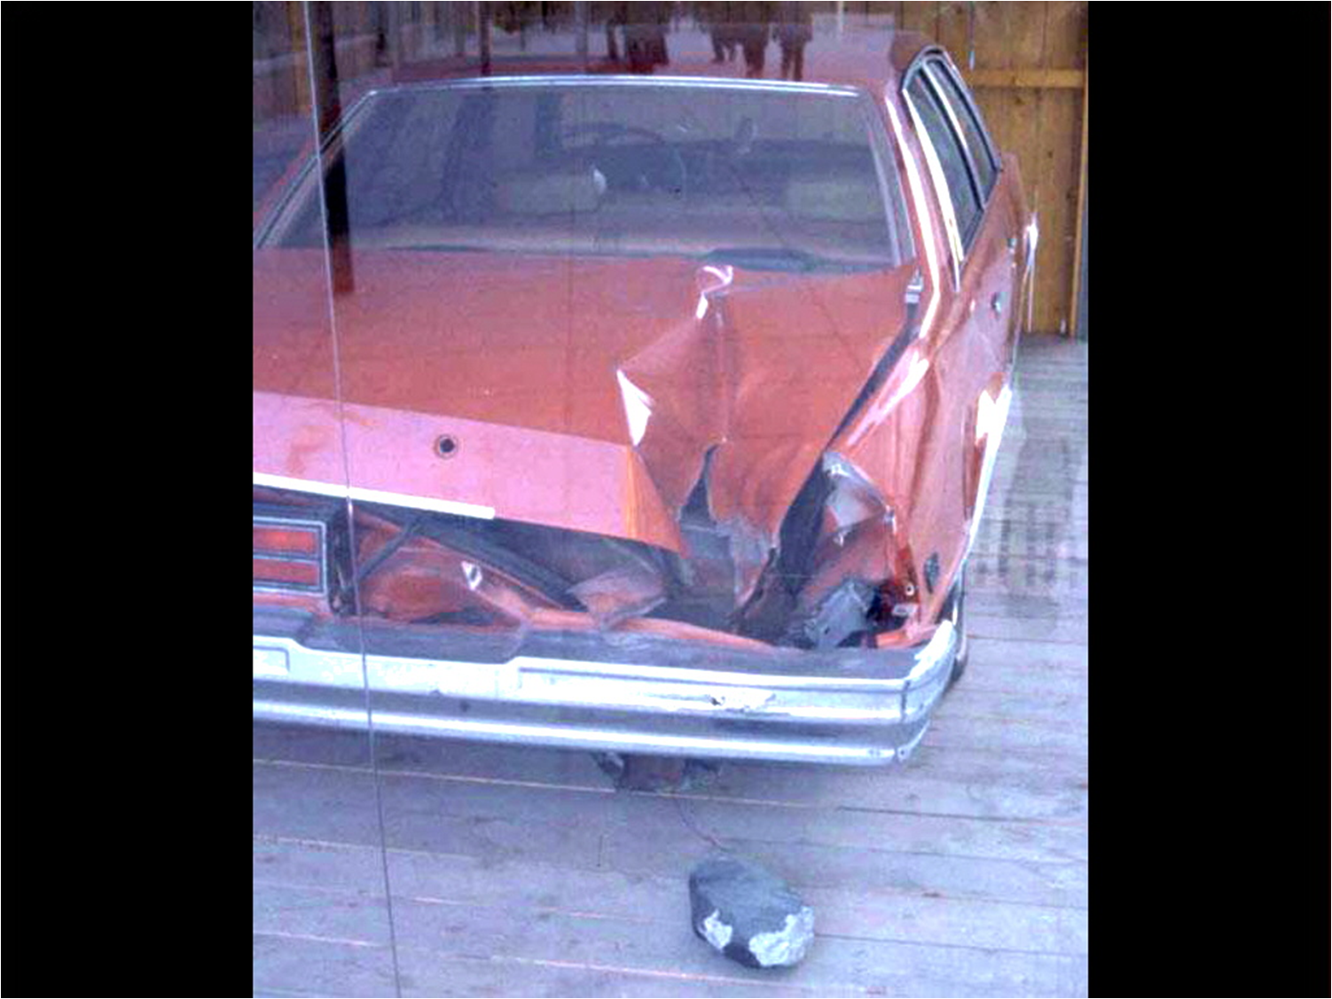
Notes:
Michelle Knapp New York City October 9, 1992 1980 Chevy Malibu

Slide 40
Meteors
You can see a couple of meteors each hour on any given night, but there are a dozen meteor showers that occur each year, that have 10-100 per hour.
These meteors seem to come from a specific constellation. This is called the radiant. Most of these showers are best viewed between midnight and dawn.

Slide 41
Major Meteor Showers
Quadrantids January 2-4 20-100 per hour
Lyrids April 21-22 12-15 per hour
Eta Aquarids May 5-6 20-60 per hour
Southern Delta Aquarids July 27-28 20 per hour
Perseids August 11-12 60-100 per hour
Orionids October 21-22 20 per hour
Taurids November 5-6 5-10 per hour
Leonids November 17-19 20 per hour
Geminids December 13-14 50-70 per hour
These showers occur regularly as the Earth passes through an area of space that a comet has passed through.

Slide 42
Fireballs Reported by US Government Sensors
(1988-Apr-15 to 2018-Feb-01)

Slide 43
The Chelyabinsk Meteor was a Superbolide caused by an
approximately 20-metre near-Earth asteroid that entered Earth's
atmosphere over Russia on February 15, 2013

Slide 44
Jupiter
The King of the Planets. It is 2 ½ times more massive than all the other planets combined.
It is composed of mainly Hydrogen and Helium like our Sun. If Jupiter had 80 times more mass, it would have started Nuclear Fusion, and would be our second Sun!
Jupiter rotates on its axis once every 9 hours 54 minutes. It has the shortest day in the solar system.
Photo by Dave Kube

Slide 45
Jupiter
Great Red Spot
Jupiter is a restless world, It has huge storms that seem to rage for eternity. The great Red spot is one of these storms. It was 1st seen by Galileo in 1610, and is still raging on Jupiter today. The storm is nearly 3 times bigger than the Earth.

Slide 46
Jupiter’s Moons
Updated: December 6, 2017
Jupiter has 53 named moons. Sixteen more moons have been sighted and are awaiting confirmation of discovery before they get official names. Combined, scientists now think Jupiter has 69 moons.
The planet Jupiter's four largest moons are called the Galilean satellites after Italian astronomer Galileo Galilei, who first observed them in 1610. The German astronomer Simon Marius claimed to have seen the moons around the same time, but he did not publish his observations and so Galileo is given the credit for their discovery.

Slide 47
These are the four Galilean Moons
From the Top
IO
Europa
Ganymede
Calisto

Slide 48
View of Jupiter’s Inner Satellites and Rings
This cut-away view of the components of Jupiter’s ring system shows the geometry of the rings in relation to Jupiter and to the small inner satellites, which are the source of the dust which forms the rings.

Slide 49
Saturn
Known as the ringed planet, is a large planet too, but it is much less dense than Jupiter. It is actually less dense than water. That means it would float in a bathtub, if you had one, planet sized!
All the gas giants have rings, but only Saturn’s can be seen from Earth with small telescopes.

Slide 50
Saturn
From Earth we can watch Saturn go through its seasons. Saturn’s rings will be viewed edge on every 15 years or so.
Saturn is approximately 886 million miles from the Sun.

Slide 51
Saturn’s Rings
Saturn’s rings look solid, but they are really made up of rock, dust, and Ice. The items range in size from dust grains to objects the size of a small car.
The part of the rings seen easily from Earth is less than 1 kilometer thick.
The rings are held in place by the many moons of Saturn.

Slide 52
Saturn’s Moons
Updated: December 6, 2017
The Voyager and Pioneer flybys of the 1970s and 1980s provided rough sketches of Saturn’s moons. But during its many years in Saturn orbit, NASA’s Cassini spacecraft discovered previously unknown moons.
Four spacecraft have visited the Saturn system, but Cassini alone actually orbited the ringed planet. Doing so bought Cassini time—more than a decade—to linger and watch Saturn’s exotic zoo of 60 plus moons like no spacecraft before.

Slide 53
With a large telescope and dark skies we can see 5 of Saturn’s Moons
They are.. Titan, Rhea, Iapetus, Dione, Tethys

Slide 54
Titan
One Interesting thing about Titan, is it has an atmosphere. Titan’s atmosphere is 60% denser than the Earths atmosphere.
Is the 2nd largest Moon in the Solar System – Jupiter’s Ganymede is 2% Larger –
This composite (Above) Infrared Image shows a view of Saturn's moon Titan from NASA's Cassini spacecraft, acquired during the flyby on Nov 13, 2015.

Slide 55
The Saturn System Through the Eyes of Cassini (e-Book)
Saturn’s North Pole Region – The Rose
NASA/JPL-Caltech/SSI
Published: April 29, 2013
https://saturn.jpl.nasa.gov/resources/7777/
https://solarsystem.nasa.gov/

Slide 56
Uranus
Uranus is 31,764 miles in diameter and is approximately 1.8 billion miles from the Sun.
This Ice giant is surrounded by 13 faint rings and 27 small moons as it rotates at a nearly 90-degree angle from the plane of its orbit. This unique tilt makes Uranus appear to spin on its side, orbiting the Sun like a rolling ball.

Slide 57
Neptune
Observations of Uranus showed irregularities in its orbit. This led to the discovery of the eighth planet Neptune in 1846. They found it exactly where their mathematical calculations said it would be.
Neptune is just a little smaller than Uranus 30,764 miles in diameter and is approximately 2.8 billion miles from the Sun.
Neptune’s blue color comes from methane gas.

Slide 58
Neptune’s Moon Triton
Triton is the largest of Neptune's 13 moons. There is one additional provisional moon making 14 total.
Triton is unusual because it is the only large moon in our solar system that orbits in the opposite direction of its planet's rotation – a retrograde orbit.
Voyager 2 – is the only spacecraft to fly past Neptune and Triton – found surface temperatures of -391degrees Fahrenheit (-235 degrees Celsius). During its 1989 flyby, Voyager 2 also found Triton has active geysers, making it one of the few geologically active moons in our solar system.

Slide 59
Pluto
Pluto’s 1st and largest moon Charon was not discovered until 1978.
Just as Neptune changes the orbit of Uranus, Something was affecting the orbit of Neptune. Astronomers worked out the math and began to look for Pluto. Percival Lowell searched with no avail. He was looking for a gas giant like Uranus and Neptune. He had indeed photographed Pluto, but it was a very tiny planet.
It was not until 1930 that Pluto was discovered by Clyde Tombaugh.

Slide 60
This composite image shows a sliver of Pluto’s large moon, Charon, and all four of Pluto’s small moons, as resolved by the Long Range Reconnaissance Imager (LORRI) on the New Horizons spacecraft.

Slide 61
Comets
Comets are made of materials left over from the formation of the Solar system.
Most newly discovered comets collide with the sun and never return. Some of these comets return again and again.
Comet Neat C/2001 Q4 May 7, 2004 taken by the Hubble Telescope

Slide 62
Comets
Some comets have a short period and come back every few years, but others are long period comets and come back after decades, Centuries, or Millenniums.
Comet Hale-Bopp Photo by Scott Conner

Slide 63
Stars
Stars are all outside of our Solar System, But they are all located in our galaxy called the Milky Way. It is estimated that there are nearly 200 billion stars in our galaxy alone.

Slide 64
Stars
Proxima Centauri is the next closest star to the sun. Even so it is 4.3 light years away. That is nearly 24 Trillion Miles!
Notes:
It would take 93,500 years to get there at current spacecrafts speeds.

Slide 65
Stars come in many sizes and shapes.

Slide 66
VY Canis Majoris may be the largest star known to date. It is so large that if it were put in place of the Sun, it would extend to the orbit of saturn.

Slide 67
Despite the fact that there are many stars larger than the Sun, the Sun is still not as small as people may think. Actually the sun is larger than 94% of all other stars.

Slide 68
Nebula
Some nebulas are created when stars die! The picture on the left is a planetary nebulae which is created by smaller mass stars. The picture on the right is a supernova remnant which is created by higher mass stars.
Cat’s Eye Nebula
Planetary Nebula
Crab Nebula – M1
Supernova Remnant

Slide 69
Nebula
Planetary Nebula – Photos by Dave Kube
Dumbbell Nebula
M27
Ring Nebula
M57

Slide 70
Nebula
Some Nebulas like these are places where stars are being born.
The Swan Nebula – M17
The Orion Nebula – M42
Photo by Dave Kube

Slide 71
Nebula
Some Nebulas like these are Dark Gas Clouds
Horsehead and Flame Nebula Photo by Dave Kube

Slide 72
Open Clusters
Open star clusters are clusters of stars that formed in a nebula like the ones in the previous slide. These stars eventually spread out and populate the Galaxy.
Double Cluster
The Pleiades – M45

Slide 73
Globular Cluster
Globular clusters orbit our galaxy. They contain hundreds of thousands of stars. Current theory is that these are the leftover cores of dwarf galaxies that have merged with our galaxy.
M13 Great Hercules Cluster
M15 Globular Cluster

Slide 74
Our Milky Way Galaxy
All the things we have seen up until now, are located within our Milky Way Galaxy. In this view, you can see where we are in our galaxy.
Our Milky Way is just one of the estimated 125 billion galaxies!

Slide 75
Other Galaxies
Galaxies come in many sizes and shapes, and are located from 2 million Ly – to over 13 Billion LY from the Earth. They are all over the known Universe.
Whirlpool Galaxy – M51
37 Million Ly
Photo by Dave Kube

Slide 76
Andromeda Galaxy – M31
Our Closest Neighbor – 2.5 Ly
Photo by Joe Bruessow (Friend of Dave Kube)

Slide 77
Splendors of the Heavens
Milky Way 10 minute exposure by Scott Conner

Slide 78
The Hubble Deep Fields
The Hubble Space Telescope took these pictures one north and one south. These pictures were taken in a small section of sky with very few known objects. These long exposure pictures show more than 1500 new galaxies in each picture.

Slide 79
Splendors of the Heavens
This is an 11.3 day exposure with Hubble Space Telescope taken Sept 24, 2003. This is an area of the sky only 1/10 of the full moon. It contains over 10,000 galaxies that have never been seen before.

Slide 80
The Evansville Astronomical Society
Thank you for visiting the Wahnsiedler Observatory. This facility is maintained by dues and donations, and rarely receives other money. If you enjoyed this program please consider making a donation. Donations can be put in the donation box located on the door. Checks should be made out to EAS.

